Slide 1
Signal Processing

Slide 2
Examples are those whose response time is in few milliseconds to few seconds like
- Digital filtering,
- Video and voice compressing/decompression,
- Radar signal processing.

Slide 3

Processing Bandwidth Demands
Signal processing application computes outputs in each sampling period. Each output x(k) is a weighted sum of n inputs y(i )’s:
a(k, i ) – Set of weights, known and fixed.
y(i )– Weighted sum of inputs
x(k) - Output

Slide 4
Radar System
System consists of an
1) Input/Output (I/O) subsystem
2)That samples and digitizes the echo signal from the radar and places the sampled values in a shared memory.
3)Array of digital signal processors processes these sampled values.
4)Data produced are analyzed by one or more data processors, which
a)interface with the display system
b)Generate commands to control the radar
c)Select parameters to be used by signal processors.

Slide 5
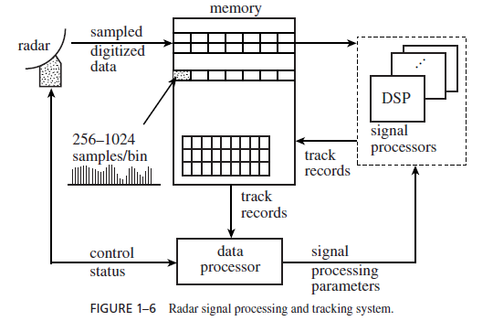

Slide 6
Procedure:
1) radar scans the area by pointing its antenna in one direction at a time.
2) it first sends a short radio frequency pulse. It then collects and examines the echo signal returning to the antenna, echo signal consists solely of background noise.
3) if there is a reflective object (e.g., an airplane or storm cloud) at a distance x meters from the antenna, the echo signal reflected by the object returns to the
antenna at approximately 2x/c seconds after the transmitted pulse, where c = 3×108 m/s

Slide 7
Tracking
Strong noise and man-made interferences, like jamming, can lead the signal processing and detection process to wrong conclusions about the presence of objects. A track record on a non-existing object is called a false return.
Tracker: Examines all the track records in order to sort out false returns from real ones and update the trajectories of detected objects.
Tracking is carried out in two steps:
1) Gating
2) Data association

Slide 8
Gating
It is a process of putting each measured value into one of two categories depending on whether it can or cannot be tentatively assigned to one or more established trajectories.
Tracker computes the predicted position(or velocity) of the object on each trajectory.

Slide 9
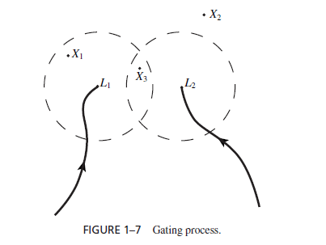
Let two trajectories L1,L2
X1,X2,X3- measured values given by three track records.
X1 assigned to L1.
X3 assigned to both L1, and L2.
X2 not assigned to any trajectories, represent false return or new object.

Slide 10
Data Association
Tracking process completes if after gating every measured value is assigned to at most one trajectory and every trajectory is assigned at most one measured value. This is the case when:
1) Radar Signal is strong and interference is low.
2) Density of object is low.
Sometimes gating may be ambiguous i.e some measured value assigned more than one trajectory then data association step is carried out to resolve ambiguity.

Slide 11
Previously,
X1->L1
X3->L1 & L2
After,
X1->L1
X3->L2
Hence X3->L1 is discarded.

Slide 12
Engineering Applications Of RTS
Metal industry applications(Mechanical and Manufacturing Engg.)
Electric utility monitoring and control application(Electric power Engg.)
Water plants applications (Civil and Environment Engg.)
Aviation and space application (Aeronautics Engg.)
Data communication application (Electrical and computer Engg.)
PetrochemicalApplication (Petroleum Engg.)

